Slide 1

Session 1: What is QA?

Slide 2
About Me

Slide 3
Contact info
parth@enlilt.com
404-820-1305
http://linkedin.com/parth.dhebar

Slide 4
The Enlilt Way
Notes:
At Enlilt, we like to do things differently. Most courses are just a multi hour long lecture, which we don’t believe in. We believe in making courses fun, personalized, and relevant for the real world.
Every course at Enlilt follows a simple three step format. The format of each class is as follows:
What are we going to learn?
Live demo of the topic
Personalized activity
Finally, we don’t believe in homework and certainly not the same homework assignment for everyone after each class since everyone learns differently.
We believe in “Personalized Activities” for each student. Each student will come up with their own “Personalized Activity” after each class and submit it for me to review before the next course. There will be no grade given for the “Personalized Activity”, instead it will be scored around three criterias - excellent, good, and needs improvement.
Any questions?
Great. Let’s get started with our first class!

Slide 5
What are we learning today?
Information and demo of the topic
Group Activity
Personalized Activity
Q&A

Slide 6
What are we learning today?

Slide 7
What are we going to learn in this course?
What is QA?
Why learn QA?
Types of QA & QA testing
Do you need to learn how to code in QA?

Slide 8
What are we going to learn?
What is QA?
How does QA work?
Test Scenarios & Test Cases
Business Requirement Document, Functional spec
Test plan, Level of Effort, Execution phase
QA testing practice
How to be great at QA & potential interview questions

Slide 9

What is QA?
QA stands for quality analysis
Quality analysis is the process of verifying the software meets specified requirements
QA’s role is to ensure a software engineering org delivers based on the needs & expectation of customers
We also break things!

Slide 10
Demo of QA

Slide 11
QA vs QC
Quality analysis is to ensure software does not have buggy code
Quality control troubleshoots and fixes code

Slide 12

Why learn QA?
Software is eating the world & it is in demand like never before
Relatively easy way to get into IT & many jobs available
Software testing will never go away

Slide 13
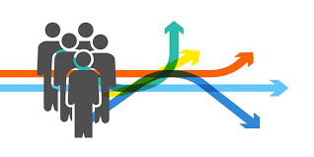
Career Paths for QA
QA Lead
Business Analyst
Engineering Project Manager

Slide 14
Types of QA Roles
Functional QA Tester or Quality Engineering
QA Automation Engineer

Slide 15
Functional vs Automation

Slide 16
Manual/Functional Testing
Process of manually testing software for defects
Requires tester to play the role of the end user of the software to test
Purpose is to identify bugs, issues, and defects in the software

Slide 17
Automation Testing
Testing is done via an automation tool
Coding experience required
No human interaction

Slide 18
Types of QA Testing

Slide 19

Mobile Testing
The process of testing a mobile app
Different architecture (Swift, Java, etc)
Verifying for functionality, usability, & consistency
Focuses on the user experience
App is tested on a mobile device

Slide 20
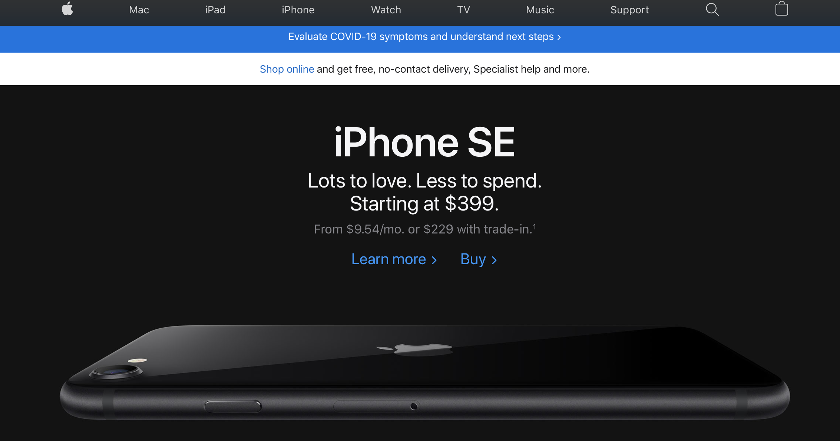
Web Testing
The process of testing a website
Different architecture (Javascript, HTML5, etc)
Input is usually mouse/keyboard instead of touch
Website is testing in a browser (Safari, Chrome, etc.)

Slide 21
Demo - Mobile testing vs web

Slide 22
Do you need to learn how to code to be in QA?

Slide 23
No.

Slide 24
Do you need to be techno functional in QA?

Slide 25
Yes.

Slide 26
Personalized Activity
Explain to me your understanding of QA
What all use cases do you see for QA?

Slide 27

What are we going to learn next?

Slide 28
Software engineering org structure
Responsibilities of working in functional QA
AGILE vs Waterfall for QA
Adhoc vs Regression testing
Unit test vs integration testing
Various phases of QA during the development cycle
Test environments

Slide 29
Q&A

